Slide 1
MyFlightbook Admin/Support

Slide 2
Overview
All accounts have one or more of the following roles
Role | Lets you…
None (Pilot) | Use the site Everyone has this
Support | Reset passwords, impersonate users, receive “Contact Us” email
Data Manager | Edit aircraft/models/airports/FAQs/Achievements/Endorsements
Reporter | View site stats, receive nightly report
Accountant | View and manage donations
SiteAdmin | All of the above plus receive errors, crash reports, etc.

Slide 3
Key Scenarios

Slide 4
Key Support Scenarios
Questions in FAQ (that’s why there’s a FAQ) – can review FAQ to see these
Forgotten passwords/Locked accounts
Feature requests or questions
Typically get 2-5 such support requests/day.

Slide 5
Key Management/Admin Scenarios
Data management and integrity
Dealing with new make/models.
Aircraft edits
Verifying site health
Crashes

Slide 6
Email

Slide 7
Emails that get sent automatically
New Manufacturer (DATA MANAGER)
Watch for dupes, or attempts at generic (e.g., “Various”, etc.)
There is a single “known” made-up manufacturer (“Generic”) in the system
Certain manufactures are only sims or anonymous.
E.g., Frasca is only a SIM,
“Generic” can be a sim or an anonymous aircraft (“Anonymous ASEL”, for example), but not a real aircraft
New model or model updates (DATA MANAGER)
Need to verify dupes, possibly merge
Common errors:
Assigning a type-ID to a non-type-rated aircraft (e.g., C-172)
Incorrect or missing ICAO identifier (I use https://www.icao.int/publications/DOC8643/Pages/Search.aspx to look up)
Duplicates of existing models – can merge using Admin->Models tool
Consistency in naming (e.g., Cessnas tend to use a hyphen, like C-172)
SIMS – best to discourage a new model for a specific sim.
E.g., people creating a model with the serial number of a specific device in the ICAO field, or one that is duplicative of an existing sim.
Edit to or clone of an aircraft that is shared among users (DATA MANAGER)

Slide 8
Automatic Emails (continued)
Nightly Stats (REPORTER)
One stats email
One email for each nightly backup that failed
A cloud backup summary <- if you don’t see this, it didn’t run!
A copy of all reminders about expiring gratuities.
Locked Account (SUPPORT)
Accounts get locked after too many unsuccessful sign-in attempts or failed password reset attempts
Admin page shows locked user, enables unlock (I usually just unlock after waiting a few minutes)
Crashes (from both website and mobile devices) (SITEADMIN)
Some can be ignored (“Invalid Postback” is the most common and ignorable)
Includes stack traces, last page visited (for website) or version (app), and username
Site problems (alerts initiated by Google Cloud monitoring)
Uptime: Google checks the FAQ page every 5 minutes.
CPU utilization – usually self-resolves

Slide 9
Customer-initiated emails
Subject generally identifies source (Website, iPad, Android, etc.)
Most questions are addressed in the FAQ.
I tend to answer them anyhow…
Blog (https://myflightbookblog.blogspot.com/) also answers a lot, particularly around why things are the way they are
Reset Password
Admin page has a Password Reset function, but self-service is best
Requests for features or flight properties.

Slide 10
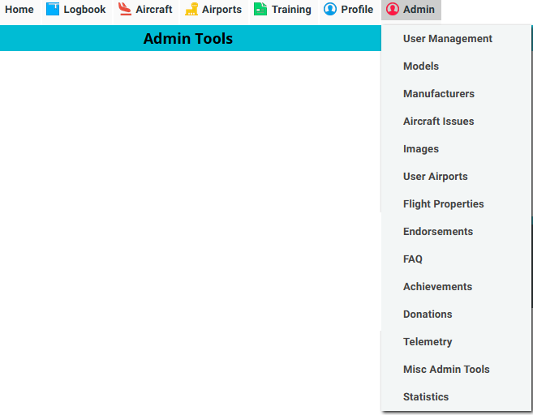
Admin Tools
Admin tab is available only to people signed in using an admin-enabled account

Slide 11
Customer Support Tools

Slide 12
Admin Tools: User management
Shows any locked accounts, enables unlocking
Type the name, username, or email of a user, then click “Find”
Search results are biased by username. E.g., “John” will find the username “John” before the million other “John” accounts
Username is generated when account is created, and is based on the left part of the email with a number added if necessary for uniqueness. E.g., uniqueemailname@gmail.com will probably get a username like “uniqueemailname”, but joe@gmail.com will get something like “joe53”
This is the account’s username; it is unique and invariant, even if email address changes

Slide 13
Admin Tools: User Management Functions
Impersonate – Emulate the user’s account (see next slide)
Reset Password: Generates a new password, along with a “Send as email” button that will send the password from the website
Delete User/Delete only flights for user: Deletes the account or just their flights
Largely obsolete - I strongly prefer that people do this themselves by going to Profile->Account->Big Red Buttons
Disable 2FA: sometimes people who have turned on 2-factor authentication lose their authenticator apps; this disables 2FA for the account.
Send Message: lets you send a simple message to the user from the website
Endow Club Creation: Club creation is generally a feature that is reserved for people who donate at a given level; this enables club creation for a specific user if you wish to grant that.

Slide 14
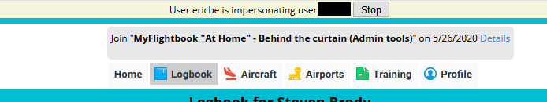
User impersonation
Header says your username, user being impersonated, and has a “Stop” button
The rest of the site has NO IDEA that impersonation is even happening; other than the banner, it’s indistinguishable from actually logging in as the user
This is great for troubleshooting
Note that while emulating, you lose any other admin functions unless the target user is also an admin
You can do this in the iOS or Android apps by signing out, then signing into your support-authorized account using the target user’s username followed by a colon, followed by your email, and your password.
E.g., signing in as “userabc:support@gmail.com” using support@gmail.com‘s password allows support@gmail.com account to emulate userabc, if support@gmail.com has a support role.

Slide 15
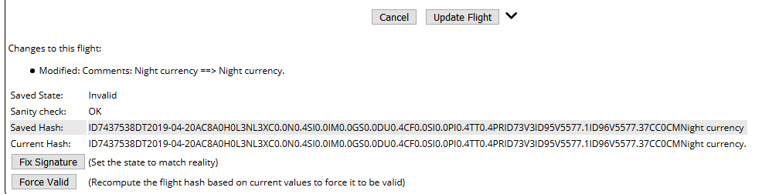
Admin Tools: Viewing Flight
a=1 in URL lets you view a specific flight (SUPPORT)
E.g.. https://myflightbook.com/logbook/Member/LogbookNew.aspx/19312138?a=1
Mostly for troubleshooting a flight without emulating the user
Can also fix signatures if they get corrupted (typical primary cause is other admin aircraft changes)

Slide 16
Data Management

Slide 17
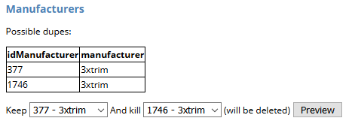
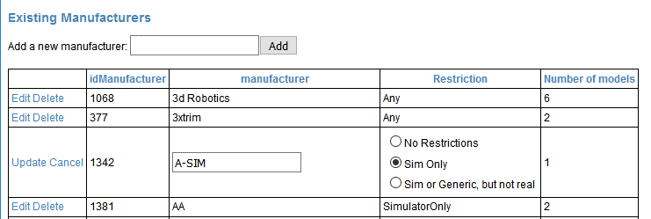
Admin Tools: Manufacturers
Can identify/merge duplicate manufacturers (much like models)
Can sort by clicking header
Delete ones with no models
Click “Edit” to modify
Generally only want to edit manufacturer restrictions, but may want to edit the name as well
Sim Only = users can only create sims with that model
E.g., Frasca, Redbird…
Sim or Generic but not real: users can create sims OR anon. aircraft, but not real
E.g., Generic

Slide 18
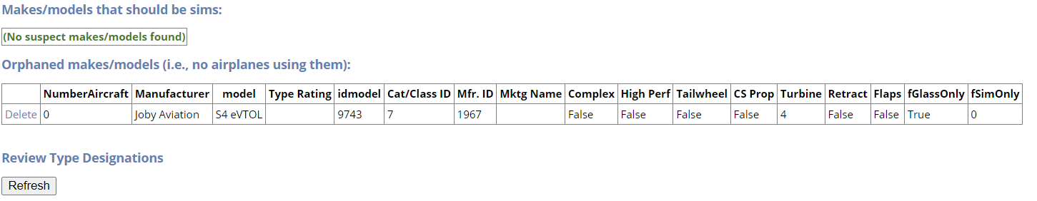
Admin Tools: Models
Review data integrity
Displays models that have no sim/generic restriction, but whose manufacturer specifies that they should.
Can arise if restriction applied to manufacturer after model is created
Review/delete orphaned models (see next slide)
Review models with type designations to ensure that they are consistent and appropriate.
E.g., C-172 shouldn’t have a type rating, all Boeing 777’s should have a type rating of “B777”, not a mixture of “B-777” and “B777”, etc.
Click “Refresh” to view them
Type ratings follow conventions at http://registry.faa.gov/TypeRatings/

Slide 19
Admin Tools: Orphaned Models
Good to periodically clean these up
Let them sit for at least a few days so that pilots can create an aircraft using them
Deleting a model may leave an orphaned manufacturer to clean up, so check that after deletion

Slide 20
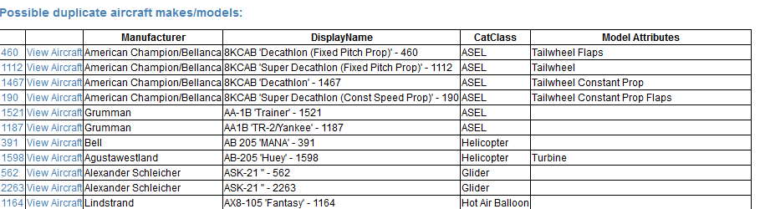
Admin Tools: Models
Identifies models that appear to be dupes of one another.
Can click model ID to view details, or view aircraft

Slide 21
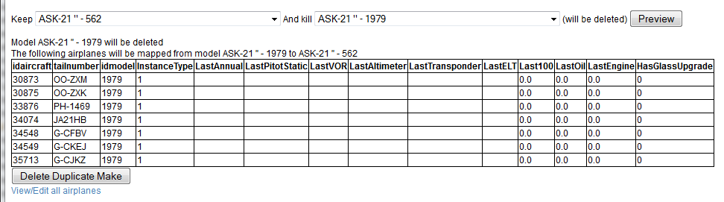
Admin Tools: Duplicate Models
Drop-downs let you decide which to keep and which to kill.
“Duplicate” is defined based on model, ICAO ID, and type rating
Important: This will send an email to all affected users if the model description changes, so make sure that the entire models (including marketing name, etc.) are identical before merging.
Click Preview to see which aircraft will be mapped, then Delete Duplicate Make to consolidate.
I generally preserve the one that modifies the fewest aircraft, or the oldest one (lowest modelID)

Slide 22
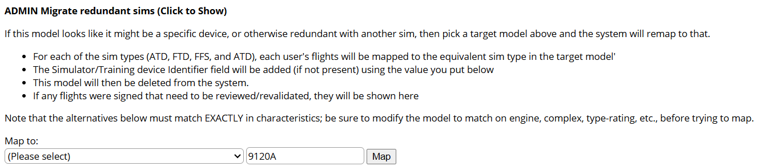
Admin Tools - Sims
People often create redundant sim models, or models that are a specific device. (e.g., someone creates “CAE FAA123”)
Edit the model and click to expand “Migrate Redundant Sims”
“Map to” will list existing sims that have the same characteristics. The 2nd field has the identifier for the device; this will go into the user’s “Simulator/Training Device Identifier” field for any entries that are affected. Click map to migrate the sim
After mapping, some signed flights may have been affected; click on each of these to review and fix the signatures as needed. (See separate section on reviewing signed flights)
The instances of sims for this model will now be orphaned. Delete the orphans, and then this redundant model will be orphaned and can be deleted under Admin->Models

Slide 23
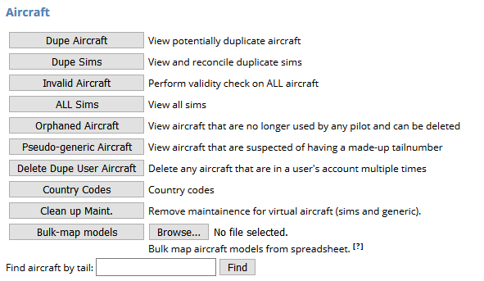
Admin Tools: Aircraft
Dupes: show aircraft that could be duplicates of each other
Dupe Sims: when models are merged, could be dupes.
In a set of duplicates, can click “Keep this” to resolve the duplicate for the same model/sim level
Invalid Aircraft: does an integrity check on all aircraft
All Sims: displays all sims in the system, allows for renaming. Just informational, really.
Orphaned Aircraft: displays aircraft that have no owners
E.g., pilot created it, then removed it from their profile.
Good to clean these up periodically; doing so can reveal models that are also orphaned, and possibly cleaning that up would reveal an orphaned manufacturer.
Pseudo-generic aircraft: shows aircraft that look made up.
E.g., creating a C-172 with the tailnumber “C172”, or “NGENERIC”, or things like that.
When you click “View” next to one of these aircraft, it will show you a “Migrate to Generic” button on the edit aircraft page; this will move the user to an anonymous aircraft and away from this one.
Also allows for migration of made-up sims (e.g., tail “FRASCA”), I vs. 1 and O vs. 0 substitutions, and other invalid tails
Delete Dupe User Aircraft: looks for users with multiple copies of the same aircraft in their profile and resolves the dupes
Country Codes: Allows for management of aircraft prefixes
Whether or not a hyphen should be used by default
URL Template for looking up of aircraft registrations
Clean Up Maintenance: you can’t maintain a sim or generic, so this removes any such records
Shouldn’t happen
Bulk Map Models: allows bulk mapping of aircraft from one model to another. I can’t remember the last time I used this…
Find Aircraft by Tail: allows lookup of aircraft by registration. You can use * and ? Wildcards.

Slide 24
Admin Tools: Edit Aircraft
Prevent non-admins from editing this (if too many back-and-forth edits, a-la wikipedia)
a=1 in URL gives admin mode
Create a new version (clone) of the aircraft. (Follow instructions on page). This is how you deal with things like a registration being re-assigned, or an aircraft that is part-time on floats and part time on wheels.
gencandidate=1 in URL gives migration; “Generic” here means “anonymous”
Multiple versions may exist of an aircraft. “Merge into Main” will consolidate the aircraft it’s next to with the one for this page; “Make Default” makes the one on this page the “primary” version
All users flying this aircraft are shown

Slide 25
Most common data management scenarios
Email arrives “Aircraft xyz Cloned”
Click on the link in the email to view the aircraft
Do a little research to figure out which is the “correct” or current version (e.g., is it a 172? A B-737?)
Click “Make Default” on the correct version
If it’s clearly a pseudo-generic (e.g., the tail is “OTHER”), then add “&gencandidate=1” to the URL and click “Migrate to Generic”
Email arrives “New model created”
Verify that it has correct attributes (flaps, retract, high performance, etc.)
Verify correct ICAO code (click “Look up” to get FAA PDF of ICAO codes)
Verify correct type rating – often, this means removing an unnecessary one (e.g., a C-172 doesn’t have a type rating requirement)
Remove redundancies. E.g., a Cessna 172 doesn’t need “Cessna 172” in the marketing name field.
If it’s a sim, mark it as being sim-only, if needed
If the model is inherently all-glass or TAA, mark it as such

Slide 26
Rules about editing aircraft
If… | Then… | Email sent?
Aircraft is sim, or generic | NO EDIT is permitted. (Admin can edit locked aircraft) | N/A
Aircraft is locked (real aircraft) | Users cannot edit, but admins can | Yes
User is ONLY pilot with that aircraft | Underlying aircraft is edited. | No
ICAO code OR category/class changes (E.g., B-737 to C-172) | “Major change” – aircraft is cloned, user put into clone | All pilots in that aircraft + admin is notified to review. Admin has a “Make Default” button to choose preferred version
All other edits (e.g., C-172N to C-172S) | “Minor change” – underlying aircraft is edited | All pilots in that aircraft + admin is notified to review
More information:
https://myflightbookblog.blogspot.com/2018/12/aircraft-and-models.html
https://myflightbookblog.blogspot.com/2019/04/adding-and-editing-aircraft-update.html
https://myflightbookblog.blogspot.com/2023/03/import-and.html

Slide 27
Images/videos on MyFlightbook
MyFlightbook Server
2: Thumbnail
created
1: User uploads image/video/PDF
File System
DB
Client (Web or mobile app)
4: Thumbnails are served out of the server’s file system
3: Full file is uploaded to S3
Amazon S3
5: Full image/video/PDFs are served from Amazon S3

Slide 28
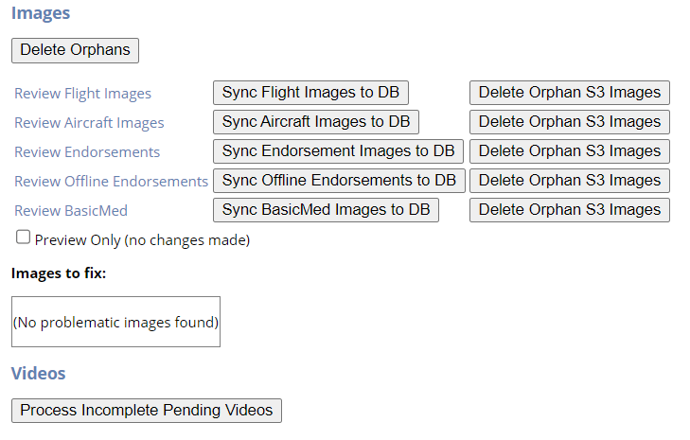

Admin Tools: Images
Delete Orphans: (OBSOLETE) resolves inconsistencies when images are around after a flight/aircraft has been deleted
Review (x) images: allows you review images, migrate any local images
Sync Flight Images to DB (OBSOLETE) – SLOW but resolves discrepancies between database and thumbnails/images on disk
Delete Orphan S3 Images: (OBSOLETE), but looks for images on Amazon S3 that aren’t in the database and deletes them
“Preview Only” prevents sync flight/delete orphan from taking action, just shows what it would do
Images to fix: two issues sometimes arise; can be fixed here:
Images that have “IsLocal” set (i.e., migration to S3 failed). Can migrate it from the “Review xxx Images” page.
Thumbnails sometimes don’t get width/height attribute correctly set

Slide 29
Admin Tool: Review Images
Can review flight images, aircraft images, and endorsements
Two goals:
Ensure compliance with appropriate usage (no obviously copyrighted material, no porn, etc.)
Delete duplicates, which sometimes arise
These pages can be slow.
There is a “Migrate” option at the top of the page to migrate images to S3. Only use this if the main images page reports that there are local images

Slide 30
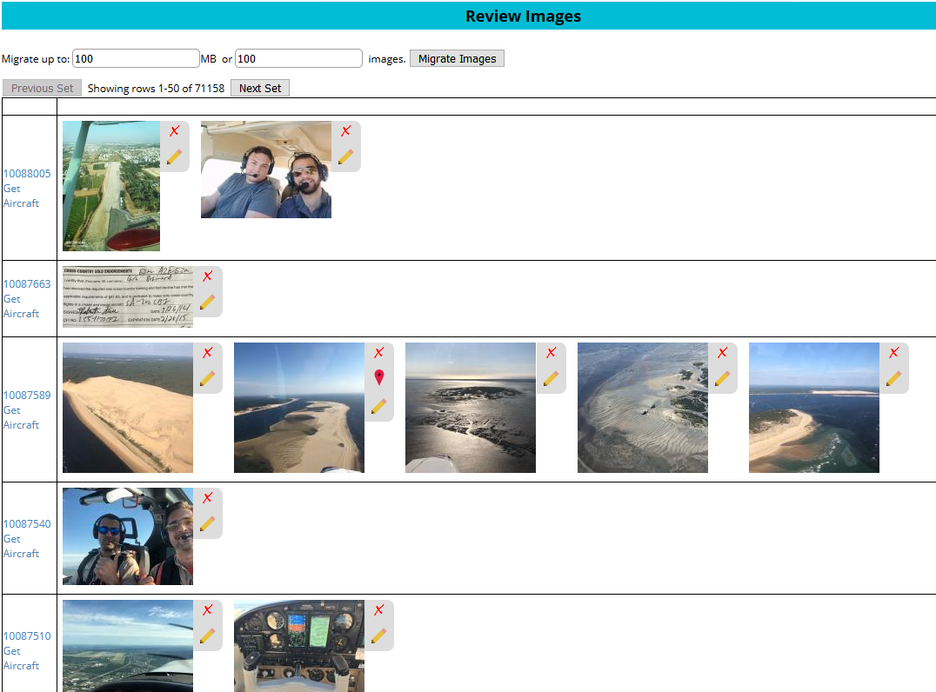
Review Images Example
Page through images
Migrate local images to Amazon S3, subject to limitations on the left
Click the “x” to delete (can’t be undone!!)
Link to underlying object (flight, etc.)
Click “Edit” to change a caption
For flights, you can get a link to the flight’s aircraft in case the image properly belongs there.

Slide 31
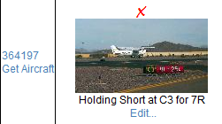
Review Images: flights
Sometimes people put images of the aircraft in their flight, and put that image on multiple flights.
When reviewing flights, there is a “Get Aircraft” link that provides a link to the aircraft for the flight
If it’s a good picture and shows the tailnumber, I will generally move the image to the aircraft and then delete from the flight
Or, if the image is already on the aircraft, simply delete it from the flight
(I confess I’ve done none of this in a few years – too much!)

Slide 32
Admin Tool: User Airports
A | Airport
C | VORTAC
D | VOR/DME
F | FAN Marker
FX | Airspace Fix
H | Heliport
L | LFR
LC | Localizer or SDF
LM | LMM
LO | LOM
M | Marine NDB
MD | Marine NDB/DME
ML | MLS or ISMLS
R | NDB
RD | NDB/DME
S | Seaport
T | TACAN
U | UHF NDB
V | VOR
Can review all user-created airports
There is also a bulk-upload tool for airports.
Bulk upload is a CSV file with columns:
FAA: FAA Designator for the airport/navaid (e.g., “SFO”)
ICAO: ICAO Designator for an airport/navaid (e.g., “PHOG”)
IATA:IATA Designator for an airport/navaid (e.g., “OGG”)
Name: Name of the airport/navaid
(Latitude, Longitude) OR (LatLong): location of the airport/navaid
Type: code (see table at right) for type of facility
I periodically update FAA airports from https://adip.faa.gov/agis/public/#/airportSearch/advanced (click “Published 5010)
When doing bulk import, can review each airport and decide whether to import, or to update existing item in database
Can also look for likely duplicate airports to resolve
Obsolete codes remain in database as long as possible
IATA, FAA, and ICAO codes are simply redundant entries
Can designate one as preferred, or at least make them match up in location. (See subsequent slide)

Slide 33
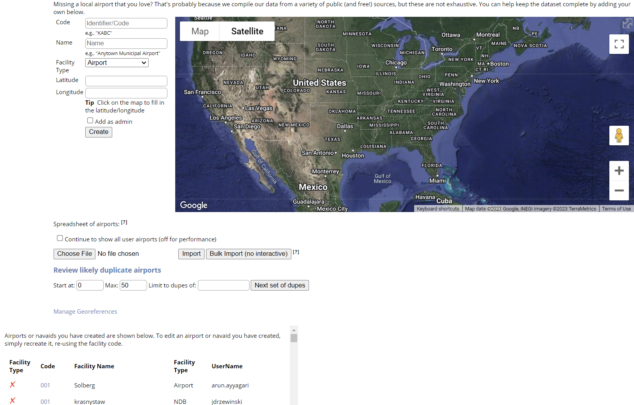
Admin Tool: User Airports
Overwrite non-user airport
DANGEROUS; DO NOT USE
Import (hover over [?] for details)
Reconcile dupes
Assign country/region
View/delete airport created by a user

Slide 34
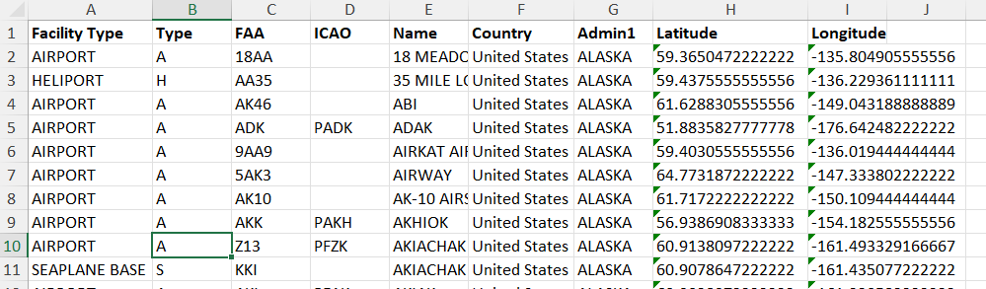
Admin Tools: User Airports, Import
This is an example of a properly formatted CSV file (from the FAA, in this case) for import
Note that “Facility Type” is ignored; it’s there to generate the “Type” code
Beware of Excel doing stupid things like treating a code like “2E3” as (numerical) 2x10³ (i.e, 2,000). Make sure the column is formatted as text!

Slide 35
Admin Tools: User Airports - Import
View location on the map: do this before adding!!!
New Airport: Add FAA (/ICAO/IATA)
Overwrite existing airport with the incoming data’s airport
Update existing airport location based on either incoming data or map location that you click (if map location is checked)

Slide 36
Admin Tools: User Airports - Dupes
See how far apart the airports are
“Preferred” indicates it is first among equals (usually the current ICAO code), used by the apps to determine which one to use
View location on the map: do this to pick which location to use
Once you decide which version you like, merge from that to the others. That will update their latitude/longitudes

Slide 37
Admin Tools: User Airports: Georeferences
Click a nearby airport to see its country/Admin1
Specify criteria for airports to find; click “Get Next Set” to refresh the list.
View the airport on a map to decide where it lies
“Country” = Country, “Admin1” = State or province or named region. Precede with “—” (two hyphens) if it’s contested
The Country/Admin1 of nearest airport is shown; if it’s correct, just hit “user”; otherwise, use the Edit button on the left and provide a country/admin1. These autocomplete

Slide 38
Admin Tools: Edit Properties
Title: Identifies the property (e.g., “Approaches – ILS”)
Format String: displays the property’s value (e.g., “3 ILS Approaches”). “{0}” is the placeholder for the value.
Description: Explains the purpose/usage of the property
Type: what kind of property is this (count of events, true/false, text, etc.)
Flags: indicate special semantics of the property (mostly for use in things like currency computations). Set flags using checkboxes.

Slide 39
Property Guidelines
Keep properties as general purpose as possible.
E.g., “Charity Flight” rather than “Angel Flight”
Add properties only for things that really don’t belong in comments – i.e., for which a pilot might wat to do a structured search or a pivot table in Excel
Avoid properties that combine independent things
E.g., stay away from “Night Cross-country” or “Solo Night Cross Country.”.
This is an invitation to ambiguity or errors in the data, don’t do it.
More information:
https://myflightbookblog.blogspot.com/2018/03/whats-with-these-flight-properties.html
https://myflightbookblog.blogspot.com/2017/11/combination-properties.html
https://myflightbookblog.blogspot.com/2020/09/properties-in-depth-part-1-goals-and.html
https://myflightbookblog.blogspot.com/2020/09/properties-in-depth-part-2-properties.html

Slide 40
Admin Tools: Endorsement Templates
This is where templates can be created/edited for endorsements that a flight instructor can give to a student
Uses a pseudo-markup language to specify placeholders for student name, date, etc.
{x} for a single-line entry with watermark "x"
{Freeform} for freeform multi-line text (no watermark prompt)
{Date} for the date (prefilled)
{Student} for the Student's name (pre-filled)
{x/y/z} for a drop-down of choices x, y, and z

Slide 41
Admin Tool: Edit FAQ
Link to FAQ is on bottom of every page.
FAQ items consist of a category, a question, and an answer. They are grouped by category at display time.
FAQ answer can contain HTML markup
FAQ is branding-aware (will use correct brand based on environment)
All links should use relative paths (i.e., not include the domain name) to work with multiple brands
%APP_NAME%: the name of the app
%SHORT_DATE%: Current date format (short) - date pattern
%DATE_TIME%: Current time format (long) - sample in long format
%APP_URL%: the URL (host) for the current request.
%APP_ROOT%: The root (analogous to "~") for the app brand.
%APP_LOGO%: the URL for the app logo
E.g., the “Contact” link is http://%APP_URL%%APP_ROOT%/Public/ContactMe.aspx which translates to http://myflightbook.com/logbook/Public/ContactMe.aspx

Slide 42
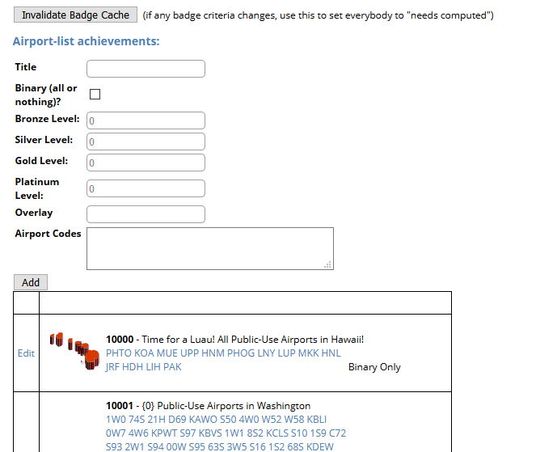
Admin Tool: Achievements
Two functions:
Invalidate cache of user achievements (i.e., force it to be computed next time they view achievements
Create new airport achievements
Airport achievements:
Title: self explanatory
Binary: if checked, this is something you achieve or you don’t achieve (and subsequent items are ignored)
Bronze/silver/gold/platinum: how many airports in the list do you need to land at to achieve these levels? (Need to be ascending)
Overlay: name of the PNG file in the Images directory that overlays the badge
Airport codes: the set of airports that comprise the achievement

Slide 43
Telemetry
Can be stored directly in the flights table, but generally not (performance)
Compressed flight path is stored in database, and original is saved to disk in .telemetry file
Avoids need to parse/reparse data, reduces bloat, increases performance.

Slide 44
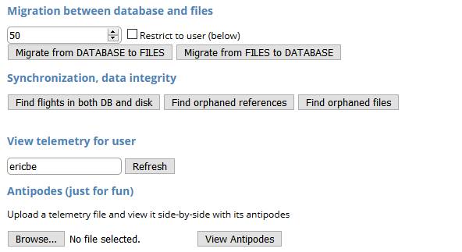
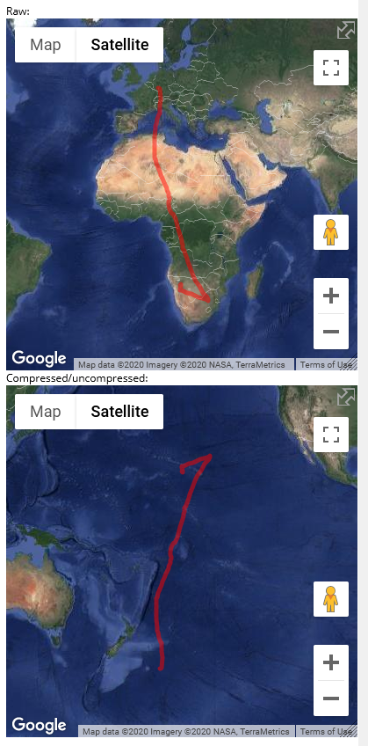
Admin Tools: Telemetry
Allows migration of telemetry between database and individual disk files (similar to images and Amazon S3)
Can also reconcile data inconsistencies, look up telemetry on a per-user basis, and see stats.
Fun “Antipodes” tool
Almost never need to work with this page

Slide 45
Admin Tools: Misc
Handle duplicate/empty properties
Just click them to view them in context and delete them (obviously only one in the case of duplicates).
I think I’ve finally caught all the scenarios where this can happen; haven’t seen dupes in a while
Investigate/recompute invalid signatures (slow!)
Can arise if aircraft changes (e.g., clone or merging of duplicate aircraft)
Best to do this on a development machine first.
Flush the cache on the live site (to pick up DB changes)
Re-run the nightly cloud backup job (only if Cloud Backup didn’t run)

Slide 46
Reporting

Slide 47
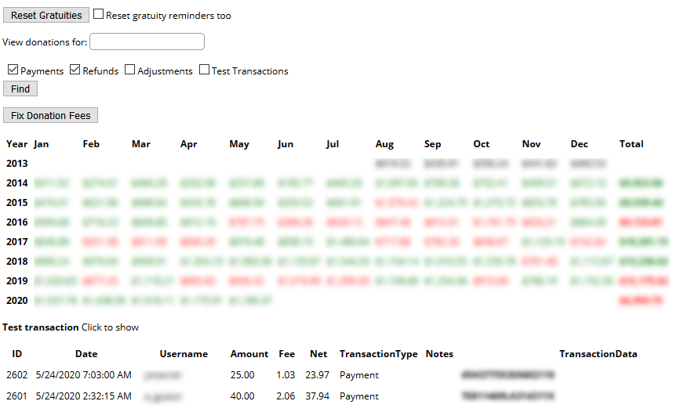
Donations
View details of donations made by time period
Search for donations by username
Add transactions manually to make adjustments
Does NOT actually issue refunds!! (just local recordkeeping)
Reset gratuities – use carefully

Slide 48
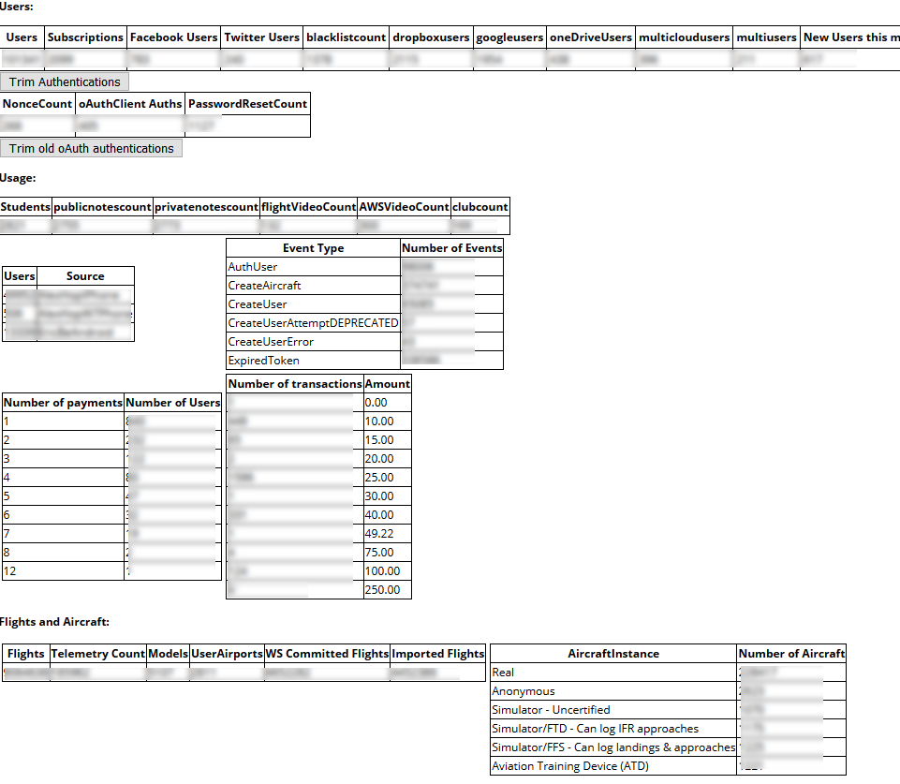
Admin Tools: Stats
Displays some interesting usage statistics for the site.
No actions necessary in this section
Emailed nightly
SLOW to compute

Slide 49
Misc

Slide 50
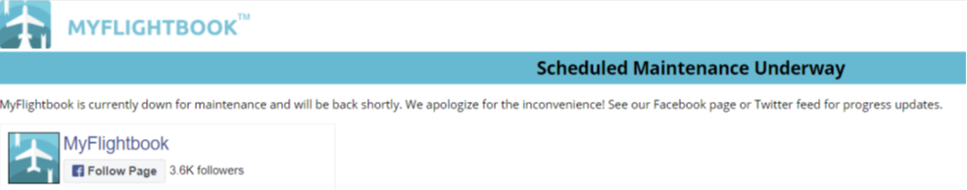
Shunting the site
Site can be shunted if necessary
LAST RESORT – CALL ME
Most site updates do NOT require shunting; this is a failsafe in case you need to stop all operations in order to maintain data integrity
E.g., if migrating to a new server
When shunted, a “Under Maintenance” page is shown
Requires editing LocalConfig table in database and then restarting the IIS process. Set ShuntState=“shunted” to shunt, anything else to un-shunt.

Slide 51
Misc: Autoreply
Can set up an “Out of office” that will auto-respond to Contact Us page
Can turn off/on in Admin->Misc tools
Replies using localized text from emailtemplates, so may need site update before turning on.
I usually only use this if I will be offline for an extended period of time

Slide 52
Site Hosting and Monitoring
Starting in 2018 and through this writing (2026), MyFlightbook is hosted on Google Cloud
Manage through Console.cloud.google.com
As of now, the services include:
One VM running Windows server 2016, ASP.Net, IIS. See the Github Wiki for more information about how to configure a server.
One MySQL instance
Amazon S3 for images, and Amazon Elastic Transcoder for processing videos
MailGun for sending email

Slide 53
Site Hosting – monitoring site health
Most important metrics are CPU and memory.
CPU can be spiky, but average should be well under 50%
Nightly run for email/backup at midnight Pacific Time can spend a couple of hours at higher load
Memory usage typically hovers in the 40-50% range
If janky, it’s best to simply restart the IIS process by using RDP into the server and using task manager (or IISReset), but clicking “Reset” on the button below can be used as a last resort.

Slide 54
Site hosting – Database Monitoring
I’ve never had an issue here
Main thing I do is an export of the “Logbook” database every couple of days so that I can have a snapshot for development use
Export to filename.sql.gz to create a compressed backup
As of Jan 2026, the full .sql file is almost 12GB.

Slide 55
Site Hosting - Monitoring
Google Monitoring is currently looking at uptime and CPU usage
/logbook/Public/FAQ.aspx?ut=1 always bypasses cache (“ut” here means “uptime”) and hits database; it’s a lightweight page
Checks for reachability ever 5 minutes or so.
Also watches for CPU over 80%
Alerts:
Sends email for issue firing, issue resolved
Sends text for issue firing, issue resolved
Contact me if you’re willing to be “on call” for alerts

Slide 56
My Contact Information
Eric Berman
Email (sorry for the “- at – “ but it should help avoid crawlers generating spam)
Myflightbook – at- gmail.com
Ericbe_expe – at - hotmail.com
Ericbe – at - hothpark.com
+1 425-765-9873 (c)

Slide 57
Questions?

